Slide 1

Statistics
Art of Making Decisions in the light of uncertainty

Slide 2
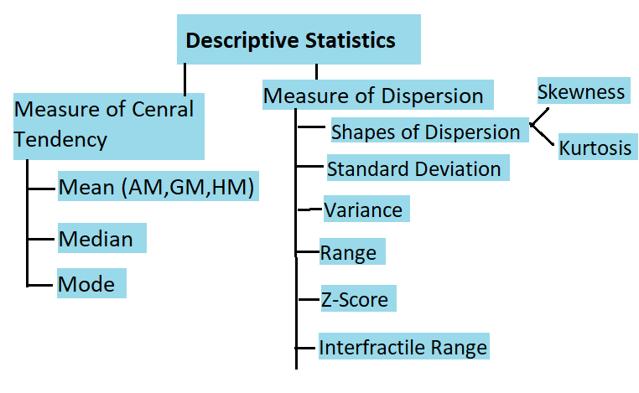
Descriptive Statistics

Slide 3
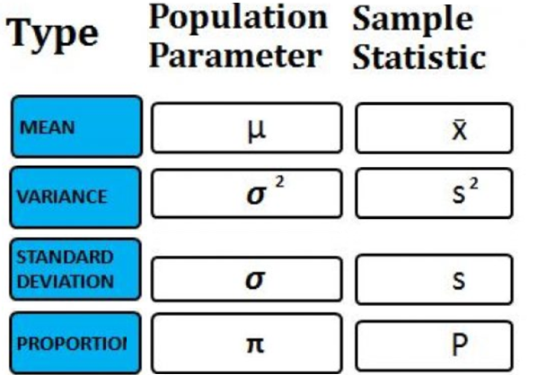
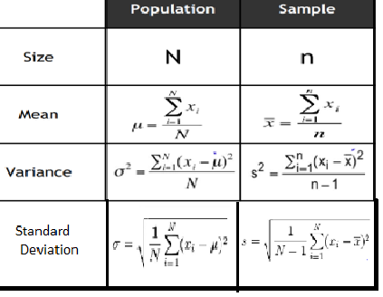
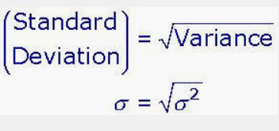

Parameters vs Statistics

Slide 4
Subscribe this Channel
Don’t forget to press the bell notifications button to get the next video directly in your inbox.
Thanks!!!

